Slide 1
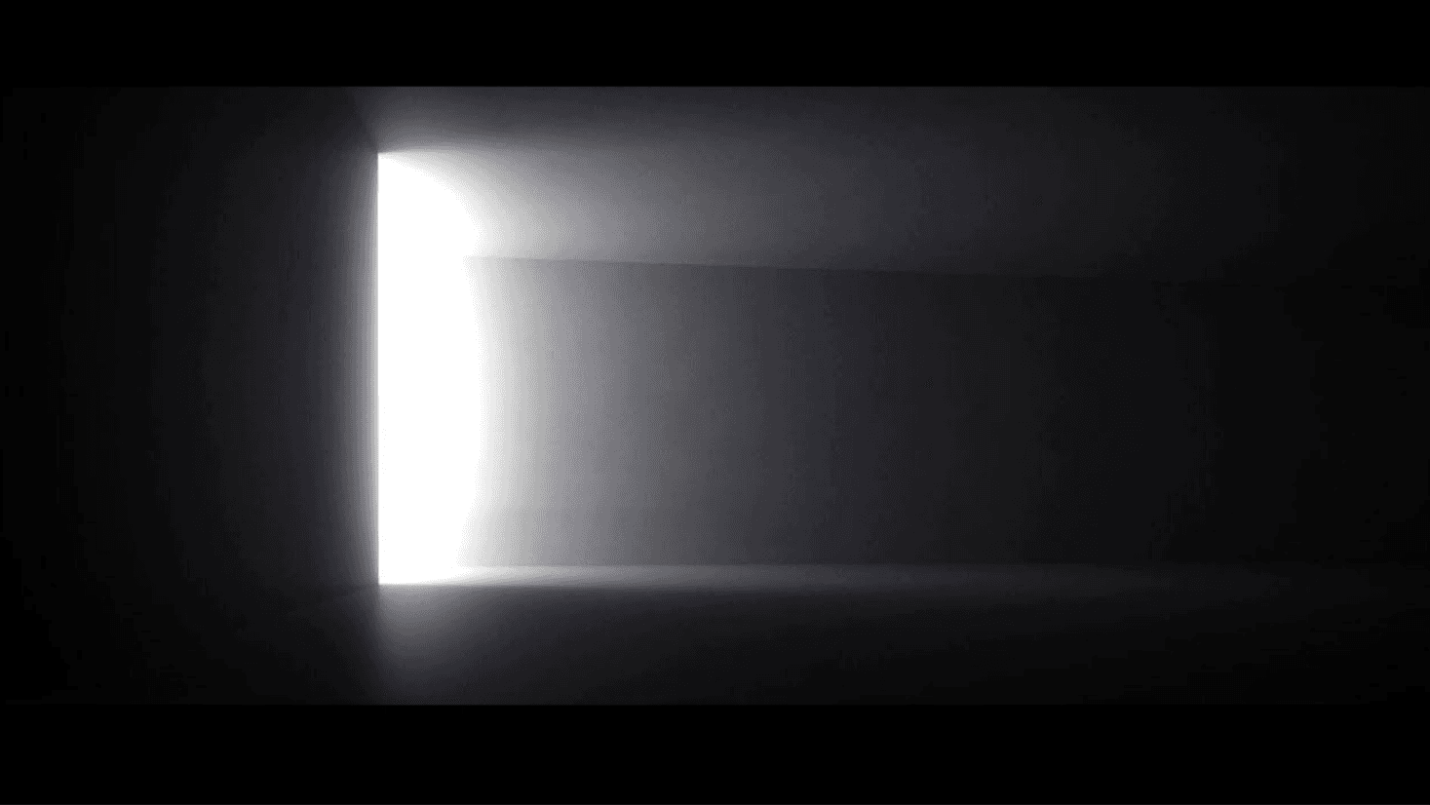

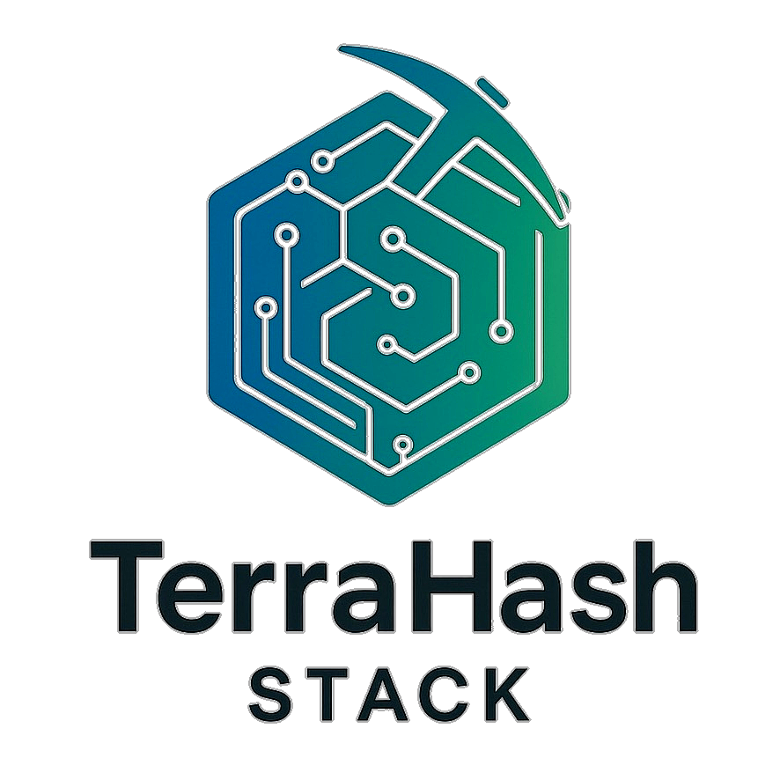
TerraHash Retrofit: Mine Smarter
2025/08/05

Slide 2



CONTENTS
01
02
03
The Crisis & The Cure
Core Tech Deep Dive
Hard Numbers
04
05
06
Q&A
Deployment Choices
Partner Proof

Slide 3

01
The Crisis & The Cure

Slide 4



Air-Cooled Mining Is Bleeding Margin
01
02
03
04
Capacity Utilization
Seasonal Revenue Loss
Downtime Costs
ASIC Lifespan
Legacy air-cooled mining operations struggle with only 67-70% capacity utilization, leading to significant revenue loss. Retrofitting with TerraHash Stack can transform this underperformance into high-efficiency operations.
In hot climates, traditional mining faces 15-20% seasonal revenue loss due to poor thermal management. TerraHash Stack’s advanced cooling technology eliminates this issue, ensuring consistent performance year-round.
Unplanned downtime costs $50,000-$200,000 per megawatt per incident. TerraHash Stack’s 99%+ uptime guarantee mitigates these costly interruptions, safeguarding your mining operation’s profitability.
Constant thermal stress shortens ASIC lifespan from 50+ months to just 30-36 months. TerraHash Stack extends equipment life by 40%, reducing costly hardware replacements.

Slide 5


TerraHash Stack in One Glance
Integrated Retrofit Solution
The TerraHash Stack is a comprehensive retrofit solution that transforms legacy mining infrastructure into a high-efficiency, AI-powered profit center with industry-leading performance improvements.
Core Technology Pillars
It integrates four core technologies: Chilldyne liquid cooling, BraiinsOS+ firmware, AI-powered operations, and automated treasury management, delivering rapid ROI and guaranteed uptime.

Slide 6
02
Core Tech Deep Dive

Slide 7




Chilldyne Cooling: Hash More, Leak Never
02
01
03
Thermal Management
Superior thermal management drops chip temperatures by 30°C, extending ASIC lifespan by 40%. This thermal headroom translates into measurable hashrate and replacement-cycle savings.
Negative-Pressure Liquid Cooling
Energy Efficiency
By maintaining optimal temperatures, Chilldyne cooling significantly reduces energy consumption per terahash, contributing to overall operational cost savings.
Chilldyne’s patented negative-pressure liquid cooling eliminates catastrophic coolant leak risks, ensuring safe and reliable operation. This technology enables 20% hashrate increases through safe overclocking.

Slide 8


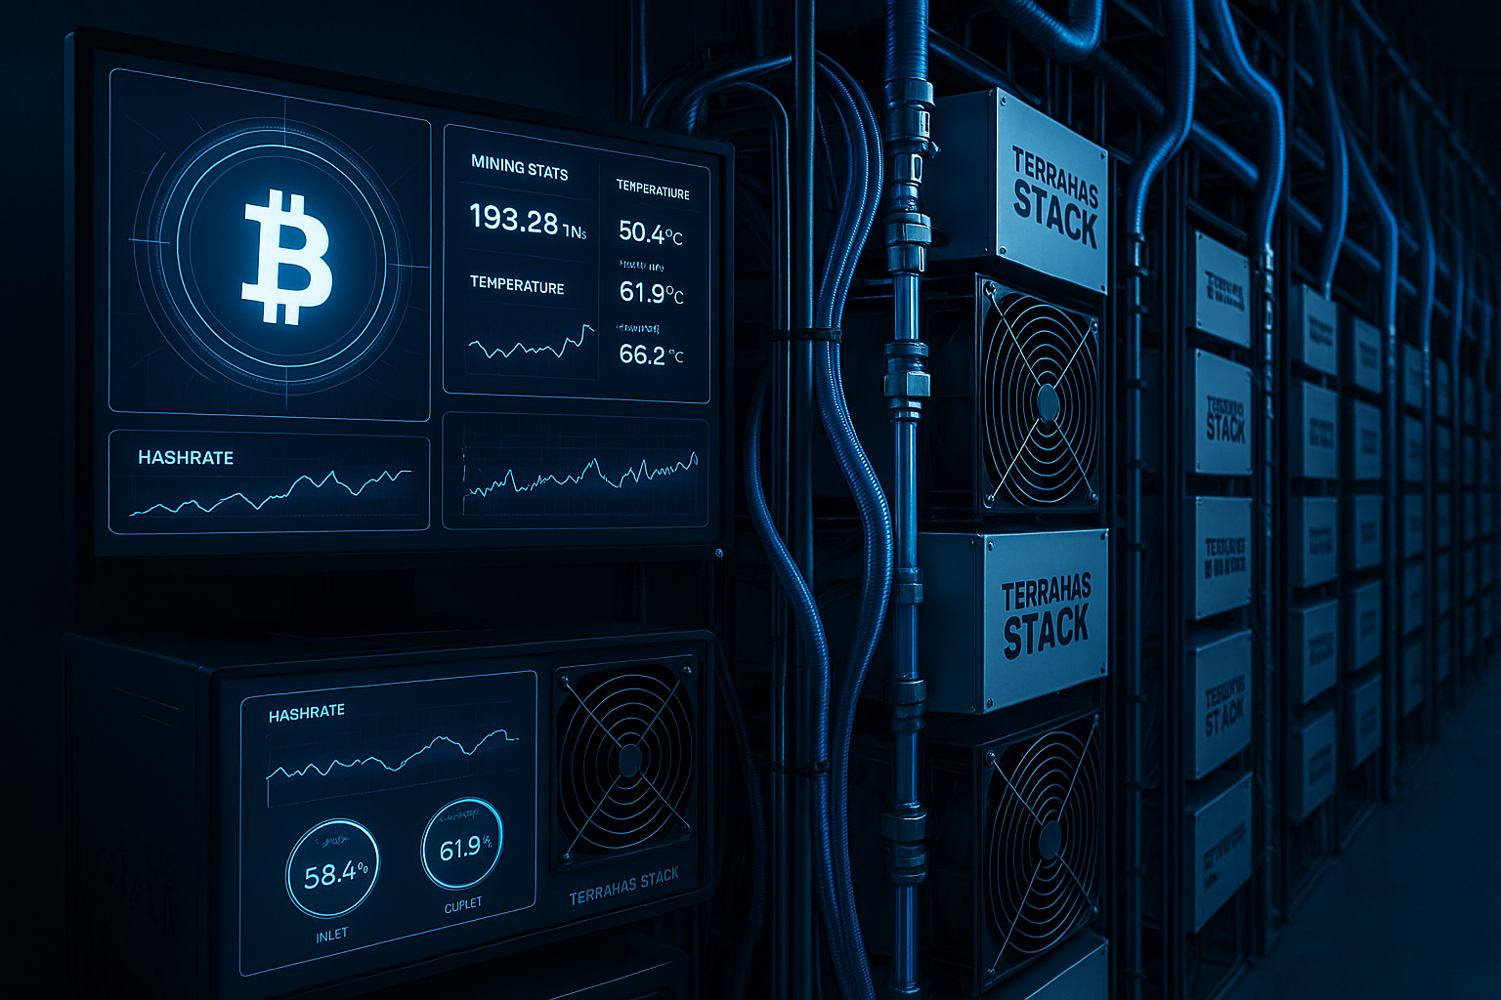
BraiinsOS+ Unlocks Hidden Efficiency
Per-Chip Autotuning
BraiinsOS+ delivers 8-15% improvement in J/TH efficiency through per-chip autotuning, unlocking the full potential of your hardware without vendor lock-in. This open-source firmware provides transparent performance metrics.

Slide 9

AI Ops & Treasury: Profit on Autopilot
03
02
Automated Treasury Management
01
Predictive Maintenance
The non-custodial treasury management system strategically allocates assets between Bitcoin and stablecoins, boosting long-term profitability by 30-60% without adding risk.
Autonomous Operations
Predictive maintenance ensures 99%+ uptime, mitigating costly downtime risks. This proactive approach keeps your mining operation running smoothly and efficiently.
AI-powered autonomous operations handle 95% of operational decisions, from real-time optimization to predictive maintenance, reducing manual interventions and maintenance costs by 60%.

Slide 10
03
Hard Numbers

Slide 11


Before vs After: The 23 % Energy Win
Energy Efficiency Gains
The TerraHash Stack reduces energy consumption from 18.5 J/TH to 14.2 J/TH, a 23% improvement. This translates to significant cost savings and enhanced profitability.
Hashrate and OPEX Reduction
It also delivers a 20% hashrate boost and a 65% reduction in operational expenses. These improvements ensure a rapid payback period of 16-24 months.

Slide 12

Payback & Uptime You Can Bank On
Rapid Payback
Performance Guarantees
With a typical payback period of 16-24 months, the TerraHash Stack offers a quick return on investment, making it a financially sound decision for your mining operation.
Fixed-price contracts with performance guarantees and comprehensive SLA support ensure your success, transferring risk from your operation to Ryno Crypto.
02
04
Guaranteed Uptime
Extended Equipment Life
TerraHash Stack guarantees 99% uptime, significantly higher than the industry average of 85-90%. This reliability ensures consistent mining operations and revenue generation.
The retrofit extends ASIC lifespan from 30-36 months to 4-5 years, reducing hardware replacement costs and maximizing the value of your investment.
01
03

Slide 13
04
Deployment Choices

Slide 14


Container, Warehouse, or Fleet-Only
Container-Based Retrofits
01
Ideal for modular deployments, 5 MW container retrofits offer a 16-20 month payback period within a 12-14 week timeline, requiring an investment of $1.8-2.2M.
Warehouse Conversions
Comprehensive overhauls for large-scale facilities (25 MW typical) provide an 18-24 month payback period within a 20-24 week timeline, with an investment of $9-11M.
02
Legacy Fleet Upgrades
03
Targeted solutions address specific operational bottlenecks with custom timelines and pricing, ensuring flexibility and tailored improvements.

Slide 15


7-Day Assessment to Signed Deal
Rapid Assessment and Deployment
Ryno Crypto offers a rapid 7-10 day facility assessment, followed by a custom engineering design, modular phased construction, and 24/7 NOC optimization. This streamlined process ensures quick deployment and value realization.

Slide 16
05
Partner Proof

Slide 17

Why Ryno Crypto, Why Now
Open-Source and Sustainable
Ryno Crypto is committed to open-source principles and sustainability. Our solutions prioritize energy efficiency, heat recovery, and renewable energy integration, ensuring responsible mining practices.
AI-Native Operations
Our AI-powered autonomous management handles 95% of operational decisions, freeing your team to focus on strategic growth initiatives. This technology ensures maximum efficiency and profitability.

Slide 18
Next Step: Book Your Free Audit
Schedule a complimentary on-site or virtual assessment to receive detailed ROI projections within a week. This zero-risk entry ensures you are making an informed decision.
Complimentary Assessment
Secure your spot for 2025 deployments to capitalize on the upcoming bull cycle. Retrofitting now maximizes your potential for profit during the next market upswing.
Lock in 2025 Deployment Slots
Contact us at info@rynocrypto.com or visit rynocrypto.com to schedule your assessment and take the first step towards transforming your mining operation.
Contact Information

Slide 19
06
Q&A

Slide 20
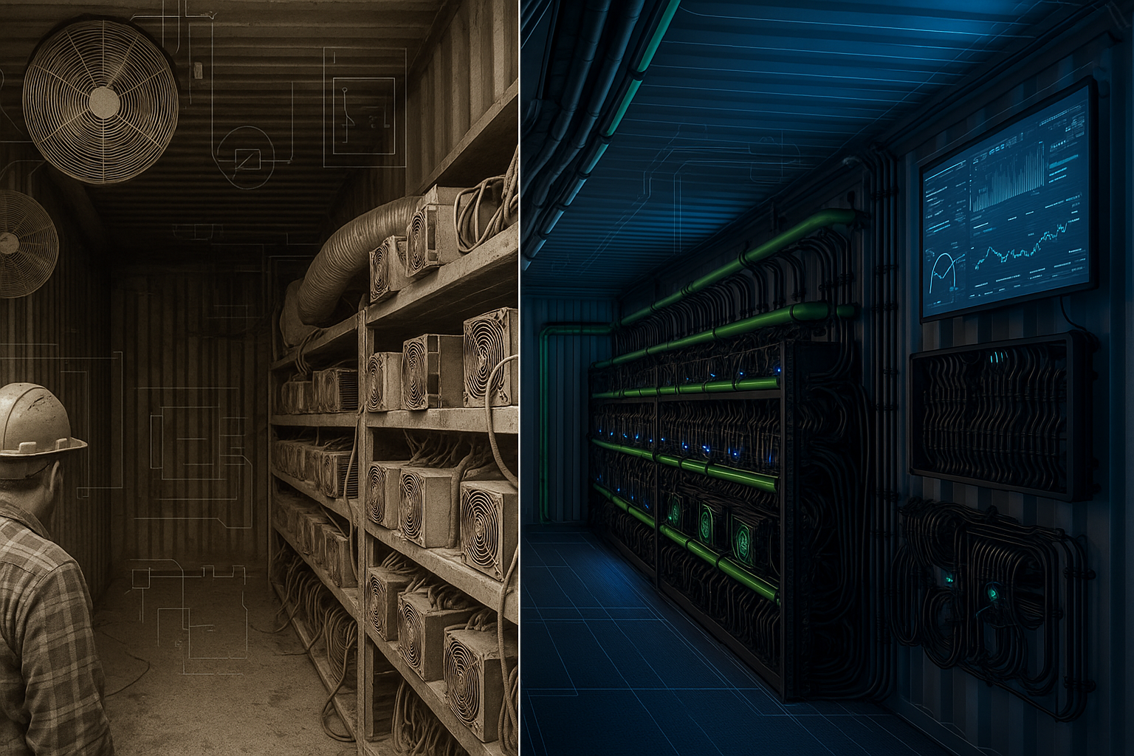
Open Floor: Ask the Retrofit Team
Q&A Session
We invite you to ask any technical, financial, or logistical questions. Our team is here to provide transparency, open-source firmware access, and SLA guarantees. Ensure you leave with a clear understanding of the retrofit benefits.

Slide 21

Thank you.
2025/08/05

